Slide 1
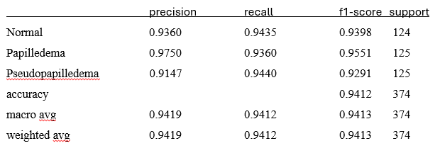
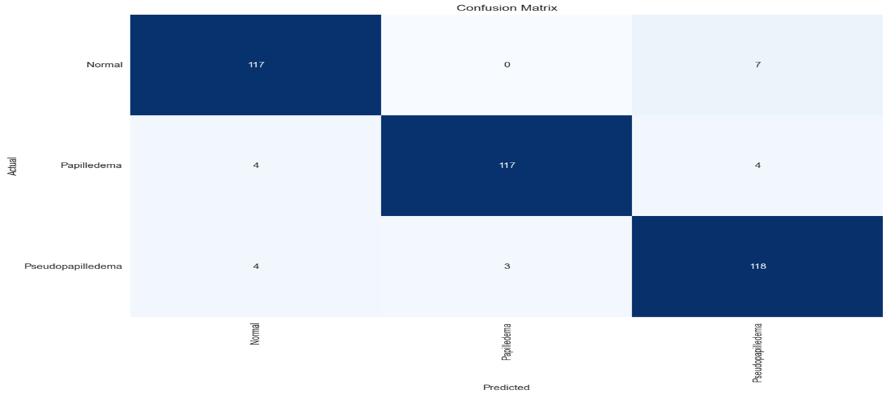
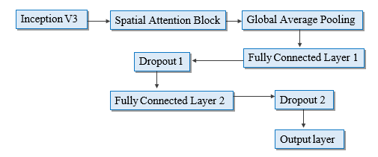
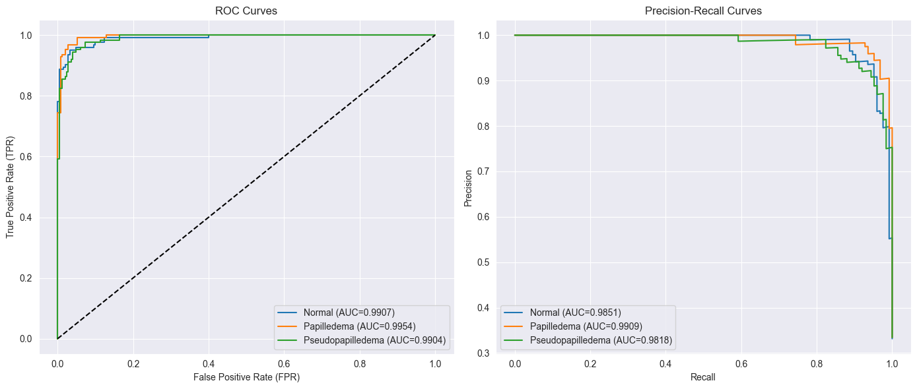
AN INCEPTION-BASED DEEP LEARNING MODEL WITH SPATIAL ATTENTION FOR PAPILLEDEMA CLASSIFICATION
INTRODUCTION /ABSTRACT
ENGINEERING STANDARDS
Papilledema, marked by optic disc swelling from raised intracranial pressure, requires early detection to prevent vision loss. Traditional methods like ophthalmoscopy depend heavily on clinician expertise. This study presents a deep learning-based approach using CNNs with spatial attention to improve papilledema detection from retinal fundus images. A balanced dataset of normal, papilledema, and pseudo papilledema images is used, with data augmentation to boost generalization. The model outperforms traditional machine learning techniques in accuracy. Standard classification metrics validate its effectiveness. This approach enhances diagnostic efficiency and supports clinicians in early, accurate detection.
ISO/IEC 23053:2022: Framework for transparent and reproducible AI/ML system.
IEEE 7000-2021: Ethical guidelines for designing fair and privacy-conscious AI systems.
DICOM Standard: Standard for medical image format and transmission.
RESULTS AND INTERFERENCE
There were 22 errors in 374 tests for an accuracy of 94.12%.
Classification Report:
MOTIVATION
Papilledema is optic disc swelling caused by increased intracranial pressure, often linked to serious neurological issues. Early detection is vital to prevent vision loss and complications. Manual diagnosis is slow, subjective, and requires expert ophthalmologists. Deep learning, especially CNNs, offers automated detection with high accuracy. This project develops an AI system to analyze retinal fundus images for faster, more precise diagnosis. Integrating AI enhances accessibility, reduces errors, and supports early medical intervention.
Confusion Matrix:
PROBLEM STATEMENT / OBJECTIVE
Develop and evaluate a deep learning method for automated papilledema detection in fundus images to improve diagnostic accuracy. Apply preprocessing techniques to enhance image quality for better model performance. Select a suitable deep learning architecture capable of learning papilledema-specific features. Train the model on labeled fundus images and validate its performance. Evaluate using metrics like accuracy, sensitivity, specificity, and AUC-ROC.
METHODOLOGY/ BLOCK DIAGRAM
Model Architecture:
ROC and Precision Recall Curve:
Dataset was upsampled and augmented to majority class (623 images).
80% dataset was used for training wherein 20% of it was used for validation.
Train images were heavily augmented to induce variation on upsampled data.
20% of dataset was evaluation without augmentation.
Weights obtained from pretrained on imagenet are used.
Trained on last 30 layers and other layers freezed.
2 sets of fully connected layers to increase parameters.
2 sets of dropout layers to prevent overfitting.
Training:
78s to 300s per epoch with total of 40 epochs.
Reccallbacks.
CONCLUSIONS
The deep learning model achieved a high overall accuracy of 94.12%, with strong recall across all classes—Normal, Papilledema, and Pseudopapilledema. Specificity scores above 95% and AUC values over 0.99 highlight its excellent classification capability. High precision and F1-score further confirm its robustness, making it a reliable tool for early and accurate clinical diagnosis.
REFERENCES
REALISTIC CONSTRAINTS
1. K. Fatima, T. Hassan, M. Akram, M. Akhtar, and W. Butt, "Fully automated diagnosis of papilledema through robust extraction of vascular patterns and ocular pathology from fundus photographs," Biomed. Opt. Express 8, 1005-1024 (2017).
2. Ahmed M. Salaheldin, Manal Abdel Wahed, Manar Talaat, Neven Saleh, An evaluation of AI-based methods for papilledema detection in retinal fundus images, Biomedical Signal Processing and Control, Volume 92, 2024.
3. Anandi, Lazuardiah et al. “The use of artificial intelligence in detecting papilledema from fundus photographs.” Taiwan journal of ophthalmology vol. 13,2 184-190. 1 Jun. 2023, doi:10.4103/tjo.TJO-D-22-00178.
Overfitting: Limited data may cause the Inception V3 model to overfit, reducing its generalization to unseen data.
Limited Data Availability: The dataset with 779 images may not be sufficient to train a complex deep learning model effectively.
Imbalanced Data: Unequal distribution among classes (normal, pseudo-papilledema, papilledema) can lead to biased predictions.
Testing Challenges: With limited data, setting aside a significant portion for testing reduces the training data further, making evaluation harder.
High Trainable Parameters: Inception V3 has a large number of trainable parameters, which requires adapting the dataset to avoid underfitting or overfitting.
Hyperparameter Tuning: Finding the optimal hyperparameters (learning rate, batch size, etc.) will be time-intensive and challenging with limited data
CONFERENCE PAPER PUBLICATION
International Research Journal of Multidisciplinary Scope (IRJMS) – Online Mode

